Slide 1
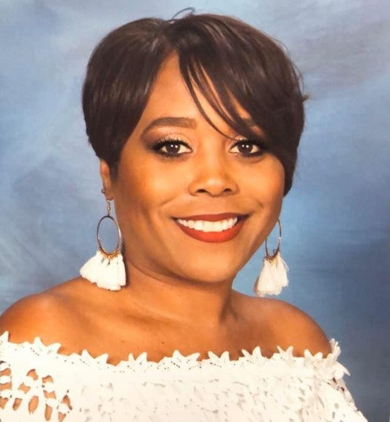
Hi! I am Ms. Stokeling. I am pleased to be your child’s 1st Grade Teacher this year. Here’s a little bit of information about myself. I was born in Hawaii, but raised here in Augusta. In 2014, I graduated from Augusta University with a Bachelor’s Degree in Early Childhood Education. This is my 9th year of teaching and making learning fun.
I’m looking forward to assisting your child to achieve his/her full potential this year. My goal is to find innovative ways to make learning fun and engaging. We will work together as a team to make sure this school year is a success. ☺
Email: stokesh1@richmond.k12.ga.us
Cell Phone: 706.564.0522
Color: Pink Candy: Jolly Ranchers Restaurant: Red Robins Candy Bar: Almond joy
Hobby: Reading, Cooking Food: Pizza/Chicken Alfredo
& Shopping Subject to teach: All Subjects
Flower: Rose Sports Team: Lakers
Drink: Sprite Books: Inspirational

